Slide 1

GROCERY WEBSITE
DATABASE MODELING AND CREATION OF API
TASK-4

Slide 2
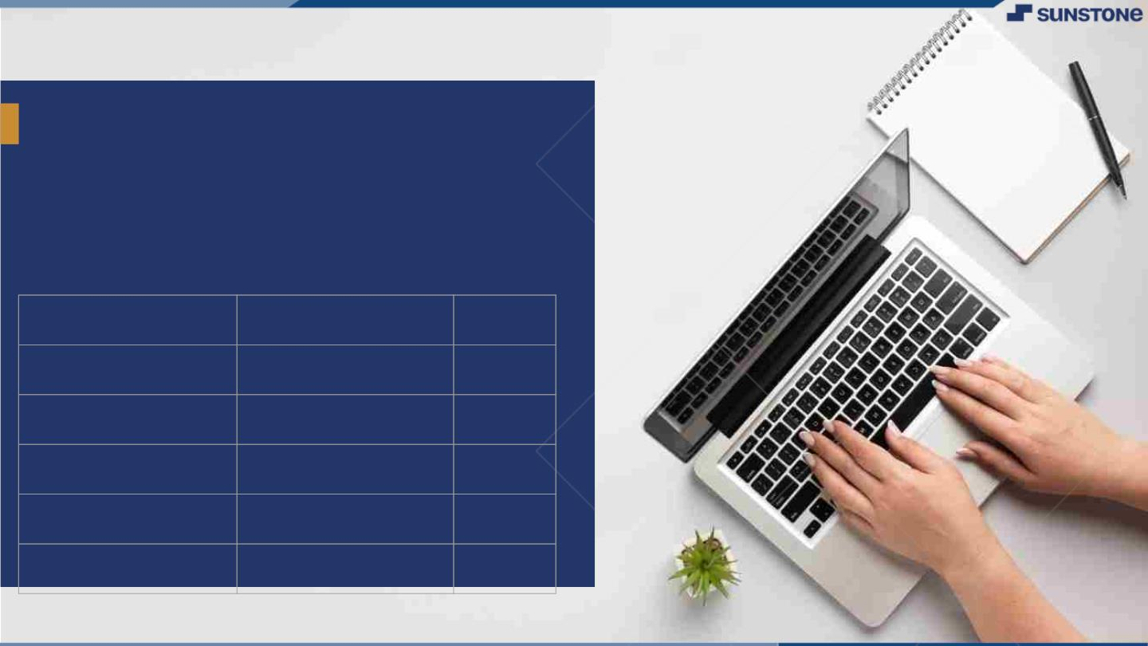
GROCERY WEBSITE
The Grocery Website Software Requirements Specification (SRS) outlines the essential features, functionalities, and constraints of a web-based platform designed to facilitate the purchase of grocery items. This document serves as comprehensive guide for the development and maintenance of the grocery website, aiming to enhance user experience, streamline operations, and ensure data security. It defines the scope of the project, its purpose, and the key stakeholders involved, setting the foundation for a successful Grocery website implementation .
NM ID
Name
Batch
au421320104025
S.PAVITHRA
5
au421320104034
B.SANTHIYA
5
au421320104038
M.SASIKALA
5
au421320104043
A.SIVAJOTHI
5
au421320104044
V.SIVATHAVASI
5

Slide 3
Integrate the API to the frontend to ensure dynamic feature:
Choose a Database System
Set Up the Database
Backend Integration
Connect Backend to the Database
Test and Debug
Implement Security Measures
Optimize and Scale
Document and Maintain

Slide 4
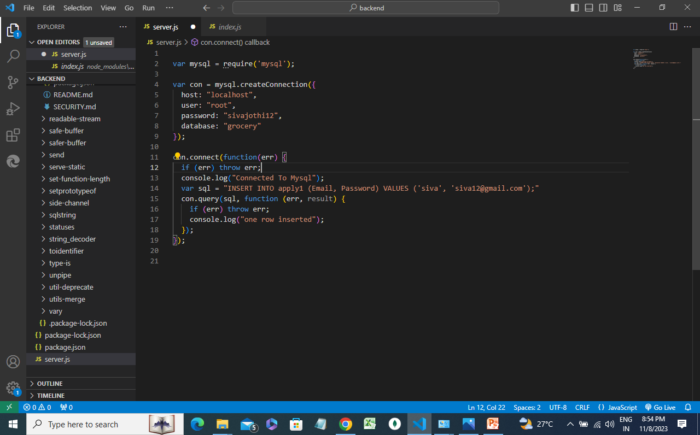
Execution and connecting to database VS code execution

Slide 5
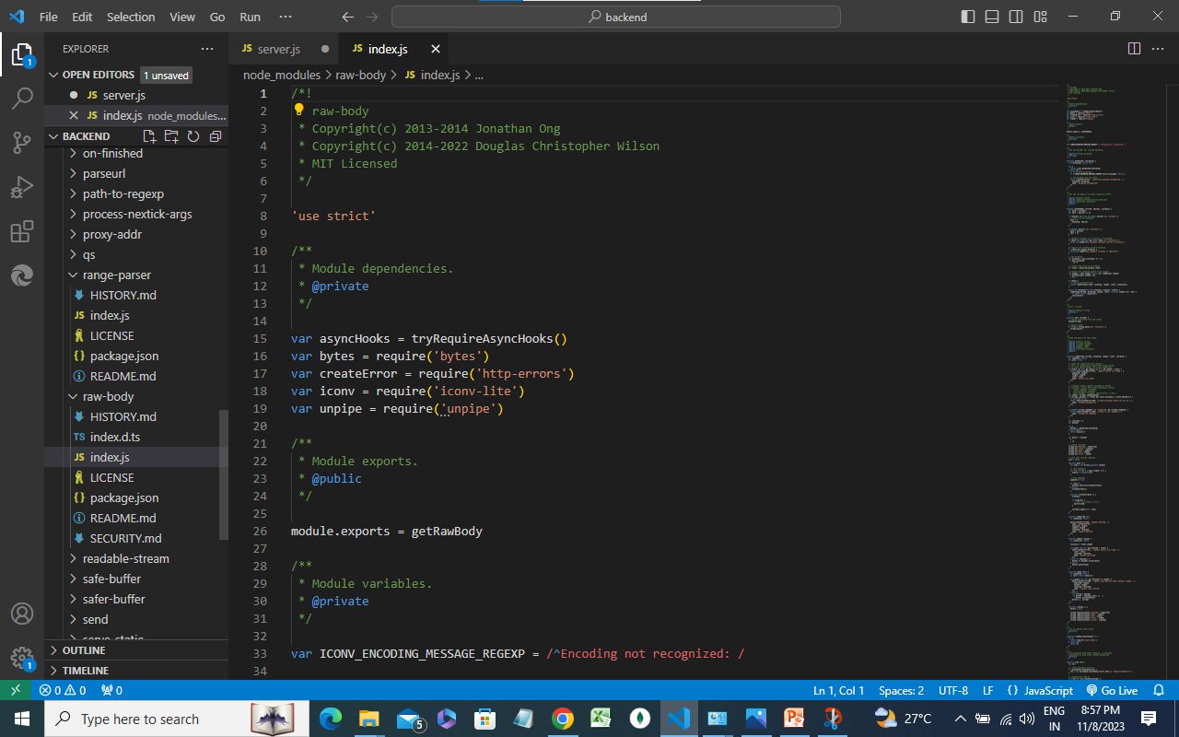

Slide 6
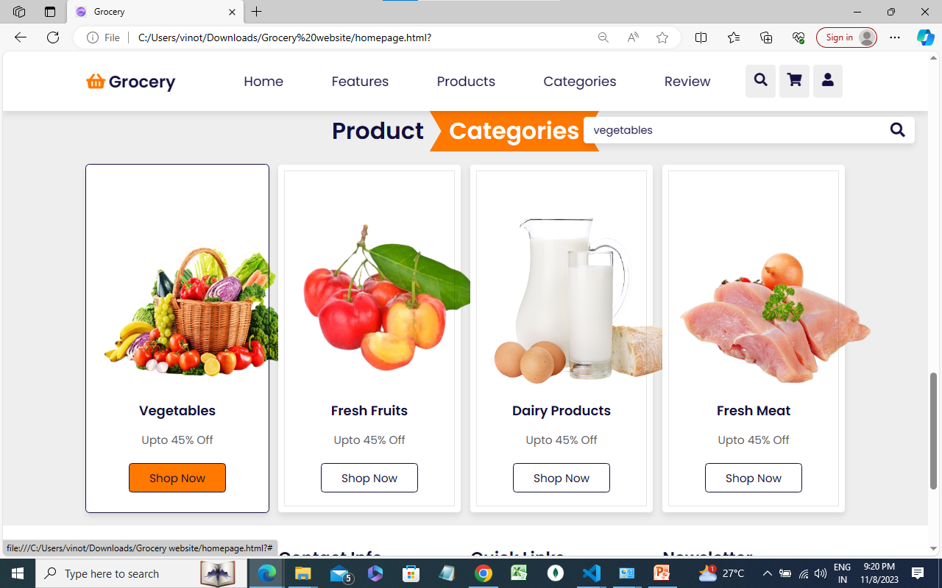
Inputting the data on to the website

Slide 7
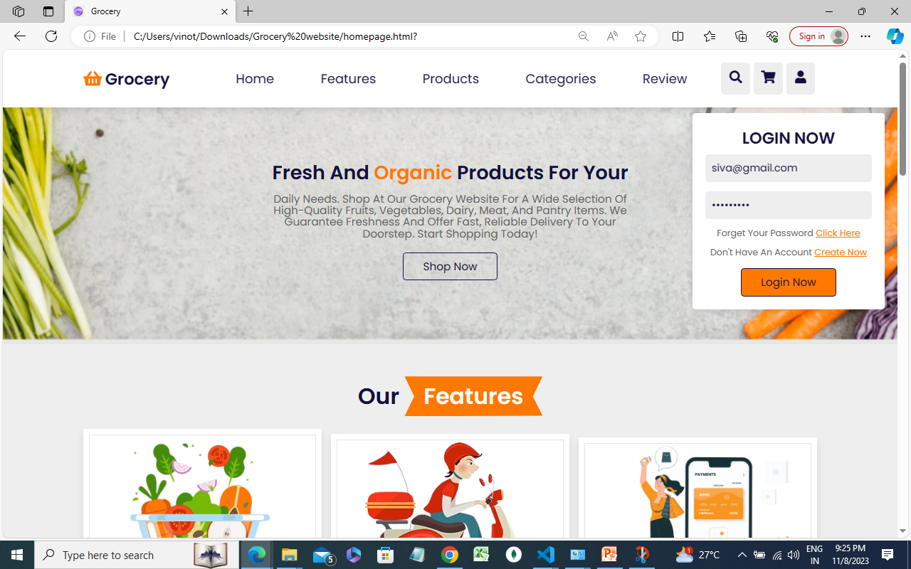

Slide 8
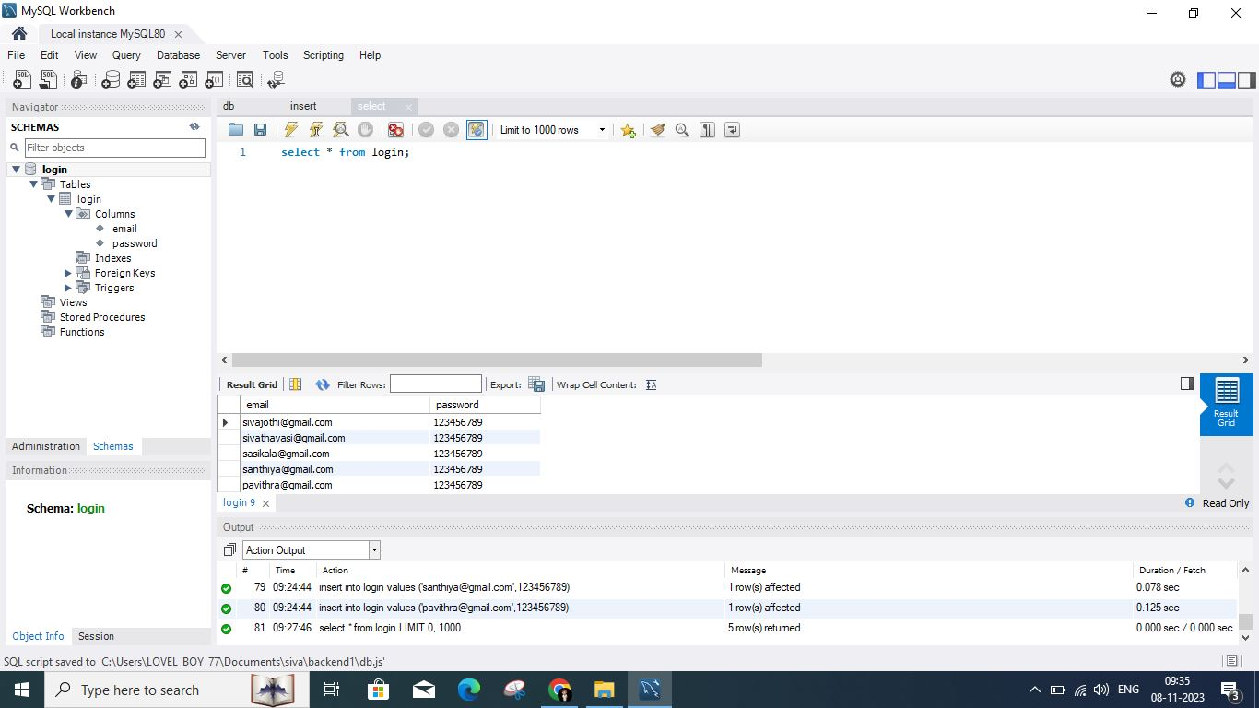
Rendering output of table components

Slide 9
Learning Outcome
The primary learning outcome for a grocery website centers on creating auser-
friendly, efficient, and convenient online shopping experience for customers.
This entails designing a website that is easy to navigate, with intuitive search and
filter features to help customers quickly find the products they need.
The website should provide comprehensive and accurate product information,
including prices, availability, and nutritional details. Ensuring a seamless
checkout process with various payment options, as well as reliable delivery or
pickup services, is crucial.
The website should prioritize security and data protection, building trust among
users. Continuous monitoring and improvement of the website's performance,
based on customer feedback and analytics, is essential for ongoing success in the
highly competitive grocery e-commerce industry. Overall, the learning outcome is to
deliver a user-centric and reliable grocery website that meets the needs and
expectations of online shoppers.

Slide 10
Step-Wise Description
Step 1: HTML Structure
Create HTML File: Start by creating an HTML file index.html.
Set Up Basic Structure: Define the basic structure with a title, container for tasks, an input field to add tasks, a button to add tasks, and an unordered list to display tasks.
Step 2: CSS Styling
Create a CSS File: Make a separate CSS file App.css.
Apply Basic Styles: Add basic styles for fonts, colors, layout, and the To-do List components.
Enhance with Interactive Styling: Optionally, add styles to display delete buttons on hover over tasks or interactive features.
Step 3: JavaScript Functionality
JavaScript File: Develop a JavaScript file Index.js and App.js for functionality.

Slide 11
Step 4: File Integration and Testing
Save Files: Save the HTML, CSS, and JavaScript files in the same directory.
Link Files: Ensure proper linking between the HTML file and the CSS/JS files.
Test the Application: Open the HTML file in a browser and test the To-do List application. Add tasks, delete them, and mark them as complete to ensure the functionality is working as expected.
Step 5: Refinement and Enhancement
Debugging and Improvement: Make necessary adjustments based on testing, addressing any issues or refining the application.
Enhance Functionality: Consider additional features like categorizing tasks, setting due dates, or using locals storage to persist tasks.
Technologies and Resources used
Frontend : HTML
Styling : CSS
Language : JavaScript
Database : My sql

Slide 12
Summary of task Product Catalog: Maintain an extensive catalog of groceries, fresh produce, packaged foods, beverages, household items, and more, organized into categories and searchable by users. User Registration: Allow users to create accounts and log in to access personalized features like order history, saved shopping lists, and preferences. Browsing and Search: Provide a user-friendly interface for customers to browse products, search for specific items, and filter results by brand, price, and other criteria. Shopping Cart: Enable users to add items to their virtual shopping carts, review and edit the contents, and proceed to checkout when ready. Checkout Process: Facilitate a seamless checkout experience, including the collection of delivery information, payment options, and order confirmation.

Slide 13
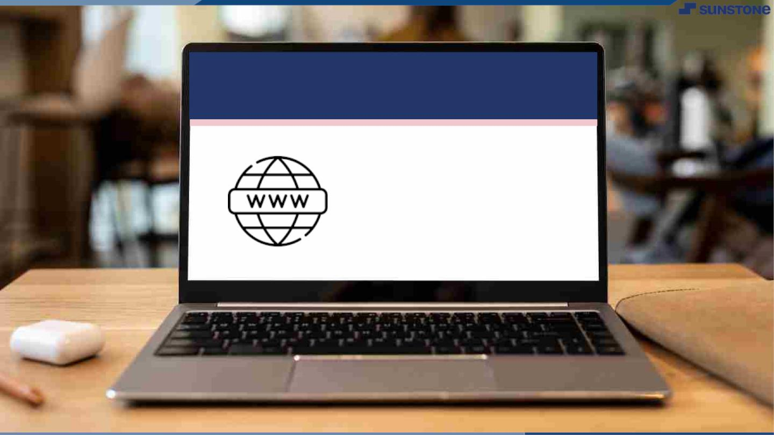
Submission Github
https://github.com/29santhiya04/Naan_Mudhalvan/tree/main/Assessment%2004

Slide 14


